Slide 1

Recursion and Backtracking
Using recursion and backtracking, recursion vs Iteration
SoftUni Team
Technical Trainers
Software University
http://softuni.bg

Slide 2
Have a Question?
sli.do
#Algorithms-Java

Slide 3
Table of Contents
Algorithmic Complexity
Brute Force
Recursion
Generating Simple Combinations
Backtracking
The 8 Queens Problem
Finding All Paths in a Labyrinth Recursively
Recursion or Iteration?
Harmful Recursion and Optimizing Bad Recursion

Slide 4
O(n)
Algorithmic Complexity
Asymptotic Notation

Slide 5
Algorithm Analysis
Why should we analyze algorithms?
Predict the resources the algorithm will need
Computational time (CPU consumption)
Memory space (RAM consumption)
Communication bandwidth consumption
Hard disk operations

Slide 6
Problem: Get Number of Steps
long getOperationsCount(int n) {
long counter = 0;
for (int i = 0; i < n; i++)
for (int j = 0; j < n; j++)
counter++;
return counter;
}
Solution:
T(n) = 3(n ^ 2) + 3n + 3
Calculate maximum steps to find the result
The input(n) of the function is the main source of steps growth

Slide 7
Simplifying Step Count
Some parts of the equation grow much faster than others
T(n) = 3(n²) + 3n + 3
We can ignore some part of this equation
Higher terms dominate lower terms – n > 2, n² > n, n³ > n²
Multiplicative constants can be omitted – 12n → n, 2n² → n²
The previous solution becomes ≈ n²

Slide 8
Time Complexity
Worst-case
An upper bound on the running time
Average-case
Average running time
Best-case
The lower bound on the running time (the optimal case)

Slide 9
Time Complexity
Therefore, we need to measure all the possibilities:

Slide 10
Time Complexity
From the previous chart we can deduce:
For smaller size of the input (n) we don't care much for the runtime. So we measure the time as n approaches infinity
If an algorithm has to scale, it should compute the result within a finite and practical time
We're concerned about the order of an algorithm's complexity, not the actual time in terms of milliseconds

Slide 11
Asymptotic notations
Asymptotic notations are descriptions that allow us to examine an algorithm's running time by expressing its performance as the input size, n, of an algorithm or a function f increases. There are three common asymptotic notations:
Big O – O(f(n))
Big Theta – Θ(f(n))
Big Omega – Ω(f(n))

Slide 12
Asymptotic Functions
Below are some examples of common algorithmic grow:

Slide 13
Typical Complexities
Complexity | Notation | Description
constant | O(1) | n = 1 000 → 1-2 operations
logarithmic | O(log n) | n = 1 000 → 10 operations
linear | O(n) | n = 1 000 → 1 000 operations
linearithmic | O(n*log n) | n = 1 000 → 10 000 operations
quadratic | O(n2) | n = 1 000 → 1 000 000 operations
cubic | O(n3) | n = 1 000 → 1 000 000 000 operations
exponential | O(n^n) | n = 10 → 10 000 000 000 operations

Slide 14

Brute-Force Algorithms

Slide 15
Brute-Force Algorithms
Trying all possible combinations
Picking the best solution
Usually slow and inefficient
0
0
0
0
0

Slide 16
Brute-Force Algorithms
0
0
0
0
0

Slide 17
Brute-Force Algorithms
0
0
0
0
1

Slide 18
Brute-Force Algorithms
0
0
0
0
2

Slide 19
Brute-Force Algorithms
9
9
9
9
9
10 x 10 x 10 x 10 x 10 = 100,000 combinations

Slide 20

Recursion
What is Recursion?

Slide 21
What is Recursion?
Method of solving a problem where the solution depends on solutions to smaller instances of the same problem
A common computer programing tactic is to divide a problem into sub-problems of the same type as the original, solve those sub-problems, and combine the results.

Slide 22

What is Recursion?
A function or a method that calls itself one or more times until a specified condition is met
After the recursive call the rest code is processed from the last one called to the first

Slide 23


Call Stack
"The stack" is a small fixed-size chunk of memory (e.g. 1MB)
Keeps track of the point to which each active subroutine should return control when it finishes executing
Call Stack
call
call
Main
Method A
Method B
return
return

Slide 24
Other Definition
Problem solving technique (In CS)
Involves a function calling itself
The function should have a base case
Each step of the recursion should move towards the base case
sum(array)
array[0] + sum(sub-array)
1 | 2 | 3 | 4 | 5
1
2 | 3 | 4 | 5

Slide 25
Array Sum – Example
Sum(n)
Sum(n - 1)
1 | 2 | 3 | 4
1
2 | 3 | 4
Sum((n – 1) - 1)
1
2
3 | 4
Sum(((n – 1) - 1) – 1)
1
2
3
4

Slide 26

Recursion
Live Demo

Slide 27
Problem: Array Sum
Create a recursive method that
Finds the sum of all numbers stored in an int[] array
Read numbers from the console
1 2 3 4
10
-1 0 1
0

Slide 28
Solution: Array Sum
static int sum(int[] array, int index) {
if (index == array.length() - 1) {
return array[index];
}
return array[index] + sum(array, index + 1);
}
Base case
Recursive call

Slide 29
Problem: Recursive Factorial
Create a recursive method that calculates n!
Read n from the console
5
120
10
3628800

Slide 30
Recursive Factorial – Example
Recursive definition of n! (n factorial):
n! = n * (n–1)! for n > 0
0! = 1
3!
3 * 2!
2!
2 * 1!
1!
1 * 0!
0!
1

Slide 31
Solution: Recursive Factorial
static long factorial(int num) { if (num == 0) {
return 1;
}
return num * factorial(num - 1); }
Base case
Recursive call

Slide 32
Direct and Indirect Recursion
Direct recursion
A method directly calls itself
Indirect recursion
Method A calls B, method B calls A
Or even A → B → C → A

Slide 33
Recursion Pre-Actions and Post-Actions
Recursive methods have three parts:
Pre-actions (before calling the recursion)
Recursive calls (step-in)
Post-actions (after returning from recursion)
static void recursion() { // Pre-actions
recursion();
// Post-actions }

Slide 34
Problem: Recursive Drawing
Create a recursive method that draws the following figure
*****
****
***
**
*
#
##
###
####
#####
5

Slide 35
Pre-Actions and Post-Actions – Example
static void printFigure(int n) {
if (n == 0) {
return;
}
// TODO: Pre-action: print n asterisks
printFigure(n - 1);
// TODO: Post-action: print n hashtags
}
Base case
Recursive call

Slide 36
0 | 0 | 0
0 | 0 | 1
0 | 1 | 1
1 | 1 | 1
Generating Simple Combinations
Recursive Algorithm

Slide 37
Generating 0/1 Vectors
How to generate all 8-bit vectors recursively?
0 0 0 0 0 0 0 0
0 0 0 0 0 0 0 1
...
0 1 1 1 1 1 1 1
1 0 0 0 0 0 0 0
...
1 1 1 1 1 1 1 0
1 1 1 1 1 1 1 1

Slide 38
Generating 0/1 Vectors
Start with a blank vector
Choose the first position and loop through all possibilities
For each possibility, generate all (n – 1)-bit vectors
0 | … | … | … | … | … | … | …
0 | … | … | … | … | … | … | …
1 | … | … | … | … | … | … | …
n - 1
n - 1

Slide 39
Solution: Generate n-bit Vectors
static void gen01(int index, int[] vector) {
if (index >= vector.length()) {
print(vector);
} else {
for (int i = 0; i <= 1; i++) {
vector[index] = i;
gen01(index + 1, vector);
}
}
}
Base case
Recursive call

Slide 40
Generating 3-bit Vectors Recursion Tree
length = 3
0
vector:
… | … | …
0
1
1
1
0
1
0
1
2
2
2
2
0
1
0
1
0
1
0
1
3
3
3
3
3
3
3
3
Print

Slide 41
Track
Recurre
Backtrack
Backtracking
Generating All Candidates

Slide 42
Backtracking
What is backtracking?
Class of algorithms for finding all solutions
E.g. find all paths from Source to Destination
V
V
V
V
D
S

Slide 43
Backtracking
How does backtracking work?
At each step tries all perspective possibilities recursively
Drop all non-perspective possibilities as early as possible
Backtracking has exponential running time

Slide 44
Backtracking Algorithm (Pseudocode)
static void recurrence(Node node) {
if (node is solution) {
printSolution(node);
} else {
for each child c of node
if (c is perspective candidate) {
markPositionVisited(c);
recurrence(c);
unmarkPositionVisited(c);
}
}
Track
Backtrack

Slide 45
Finding All Paths in a Labyrinth
We are given a labyrinth
Represented as matrix of cells of size M x N
Empty cells '-' are passable, the others '*' are not
We start from the top left corner and can move in all 4 directions (up, down, left, right)
We want to find all paths to the exit, marked 'e'

Slide 46
Finding All Paths in a Labyrinth (2)
There are 3 different paths from the top left corner to the bottom right corner:
0 | 1 | 2 | * | - | - | -
* | * | 3 | * | - | * | -
6 | 5 | 4 | - | - | - | -
7 | * | * | * | * | * | -
8 | 9 | 10 | 11 | 12 | 13 | 14
0 | 1 | 2 | * | 8 | 9 | 10
* | * | 3 | * | 7 | * | 11
- | - | 4 | 5 | 6 | - | 12
- | * | * | * | * | * | 13
- | - | - | - | - | - | 14
0 | 1 | 2 | * | - | - | -
* | * | 3 | * | - | * | -
- | - | 4 | 5 | 6 | 7 | 8
- | * | * | * | * | * | 9
- | - | - | - | - | - | 10
RRDDLLDDRRRRRR
RRDDRRUURRDDDD
RRDDRRRRDD

Slide 47
Find All Paths: Algorithm (2)
static void findPath(int row, int col) {
if (!isInBounds(row, col)) return;
if (isExit(row, col)) printPath();
else if (!isVisited(row, col) && isPassable(row, col)) {
mark(row, col);
findPath(row, col + 1); // Right
findPath(row + 1, col); // Down
findPath(row, col - 1); // Left
findPath(row - 1, col); // Up
unmark(row, col);
}
}

Slide 48
Find All Paths and Print Them
Create a List<Character> that will store the path
Pass a direction at each recursive call (L, R, U or D)
At the start of each recursive call
Add direction
At the end of each recursive call
Remove last direction

Slide 49
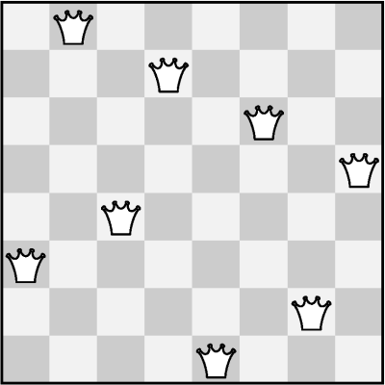
The "8 Queens" Puzzle
Write a program to find all
possible placements of
8 queens on a chessboard
So that no two queens
can attack each other
http://en.wikipedia.org/wiki/
Eight_queens_puzzle

Slide 50
Solving The "8 Queens" Puzzle
Find all solutions to "8 Queens Puzzle". At each step:
Put a queen at
free position
Recursive call
Remove the queen
static void putQueens(row) {
if (row == 8)
printSolution();
else
for (col = 0 … 7)
if (canPlaceQueen(row, col)) {
setQueen(row, col);
putQueens(row + 1);
removeQueen(row, col);
}
}

Slide 51
R || I
Recursion or Iteration?
When to Use and When to Avoid Recursion?

Slide 52
Performance: Recursion vs. Iteration
Recursive calls are slightly slower
Parameters and return values travel through the stack
Good for branching problems
No function call cost
Creates local variables
Good for linear problems (no branching)
static long recurFact(int n) { if (n == 0)
return 1;
return n * Fact(n - 1); }
static long iterFact(int num) { long result = 1;
for (int i = 1; i <= n; i++)
result *= i;
return result; }

Slide 53
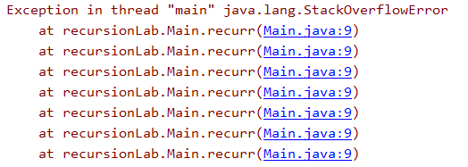
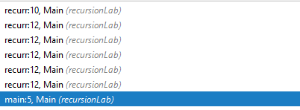
Infinite Recursion
Infinite recursion == a method calls itself infinitely
Typically, infinite recursion == bug in the program
The bottom of the recursion is missing or wrong
In C# / Java / C++ causes "stack overflow" error

Slide 54
Recursion Can be Harmful!
When used incorrectly recursion could take too much memory and computing power
static long fibonacci(int n) {
if (n <= 1)
return 1;
return fibonacci(n - 1) + fibonacci(n - 2);
}
public static void main(String[] args) {
System.out.println(fibonacci(10)); // 89
System.out.println(fibonacci(50)); // This will hang!
}

Slide 55
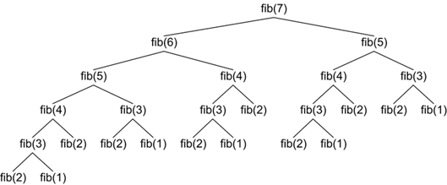
How the Recursive Fibonacci Calculation Works?
fib(n) makes about fib(n) recursive calls
The same value is calculated many, many times!

Slide 56
When to Use Recursion?
Avoid recursion when an obvious iterative algorithm exists
Examples: factorial, fibonacci numbers
Use recursion for combinatorial algorithms where
At each step you need to recursively explore more than one possible continuation, i.e. branched recursive algorithms

Slide 57

Summary
…
…
…
Algorithmic Complexity
Recursion
Backtracking
When to use recursion
When to use iteration

Slide 59










SoftUni Diamond Partners

Slide 60



Educational Partners

Slide 61

License
This course (slides, examples, demos, videos, homework, etc.) is licensed under the "Creative Commons Attribution-NonCommercial-ShareAlike 4.0 International" license

Slide 62





Trainings @ Software University (SoftUni)
Software University – High-Quality Education, Profession and Job for Software Developers
softuni.bg
Software University Foundation
http://softuni.foundation
Software University @ Facebook
facebook.com/SoftwareUniversity
Software University Forums
forum.softuni.bg

